Slide 1

Distributed Systems Lab 2 Focus: Implementation
ERMIRA Abdullahu
Junaid Abbas mohammed

Slide 2
Implementation of Bully Algorithm
Sending Election message
1
start election
5
2
start election
4
3
start election

Slide 3
Implementation of Bully Algorithm
Sending Alive message
1
start election
5
alive
2
start election
...
alive
...
4
alive
3
start election

Slide 4
Implementation of Bully Algorithm
Propagating Victory message
1
victory
5
victory
2
victory
victory
4
3

Slide 5
Implementation of Bully Algorithm
Failure Case
1
5
2
If node 5 fails to send the victory message, then node 4 takes over and declares itself as a Leader
victory
victory
victory
4
3

Slide 6
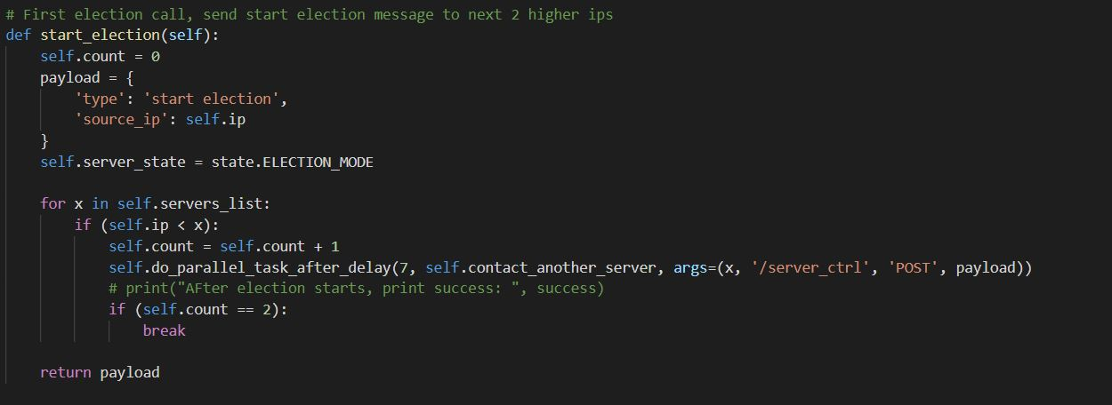

Slide 7
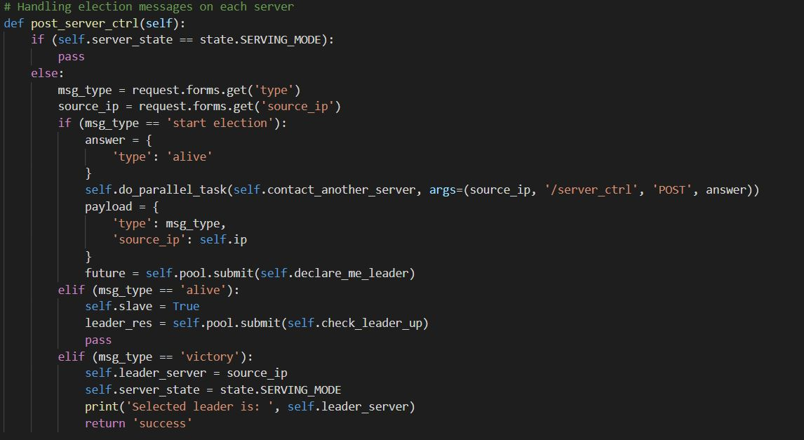

Slide 8
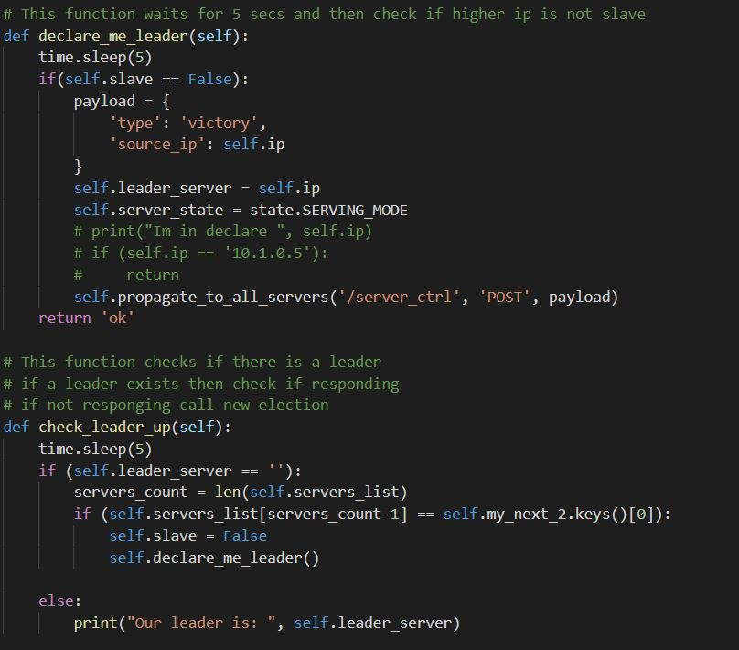

Slide 9
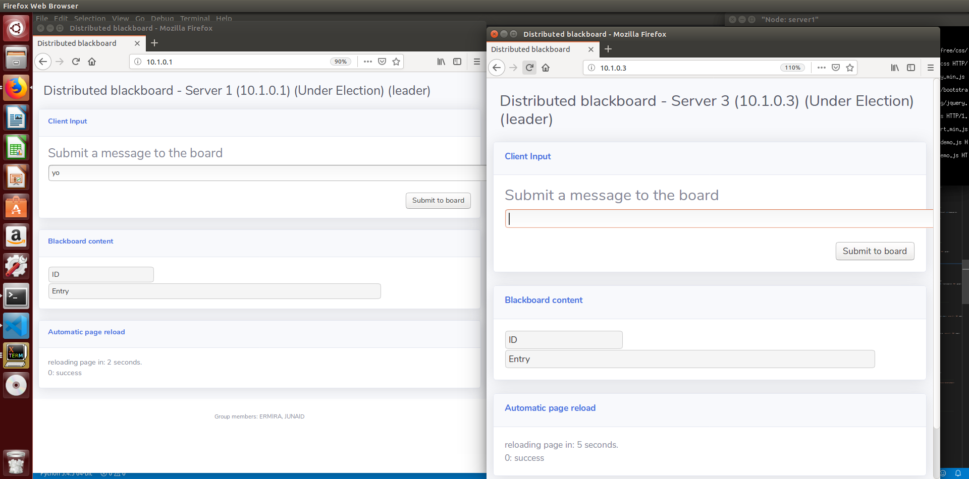
During Election

Slide 10

After Election

Slide 11
THANK YOU!

